Slide 1

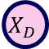
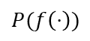
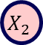
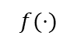
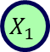
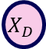
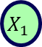
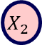
Causal Bayesian Optimization with Unknown Causal Graphs
Jean Durand
September 2024
$$X_{1}$$
$$X_{2}$$
$$X_{1}$$
Y
$$X_{2}$$
Y
$$X_{D}$$
$$X_{D}$$
Y
Supervisor: Sonali Parbhoo
Collaborators: Yashas Annadani and Stefan Bauer
Second Marker: Aldo Faisal
$$P(f\left(⋅\right))$$
$$f(⋅)$$
Surrogate model

Slide 2

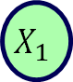
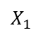
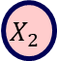
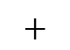
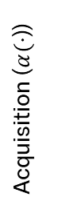
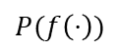
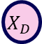
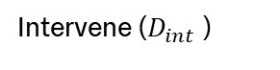
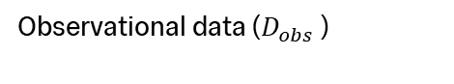
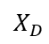
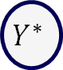
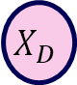
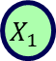
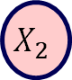
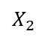
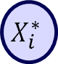
Approach
Overview
Acquisition ($α(⋅$))
…
$$X_{1}$$
$$X_{2}$$
…
$$X_{D}$$
$$X_{i}^{∗}$$
$$Y^{∗}$$
$$X_{1}$$
$$X_{2}$$
$$X_{1}$$
Y
Optimal intervention
Observational data ($D_{obs}$ )
$$X_{2}$$
Y
$$X_{D}$$
Y
$$X_{D}$$
Causal Hypothesis
$$+$$
$$P(f\left(⋅\right))$$
Intervene ($D_{int}$ )
$$f(⋅)$$
Surrogate model

Slide 3




Agenda
Overview
Background
Relate the CBO Unknown methodology to Experimental Design, Bayesian Optimization and Causal Bayesian Optimization
Motivating Experiments
Show knowledge of the full causal graph is not needed for efficient optimization
Methodology
Extend CBO to cases where the causal graph is unknown by introducing a Bayesian Posterior over the direct parents of the target variable
Results
Method is competitive with existing benchmarks and scales to larger graphs
Notes:
2.30

Slide 4
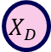
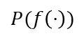
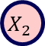
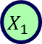
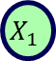
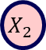
Background
$$X_{1}$$
Y
$$X_{2}$$
Y
$$X_{D}$$
Y
$$X_{1}$$
$$X_{2}$$
$$X_{D}$$
$$P(f\left(⋅\right))$$
$$f(⋅)$$
Surrogate model

Slide 5
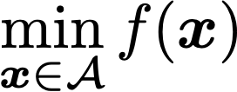
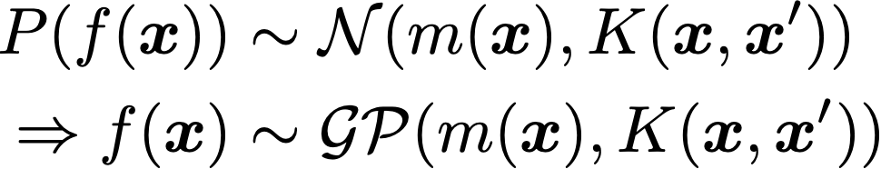
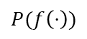
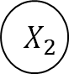
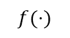
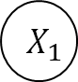
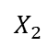
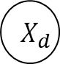
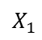
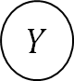
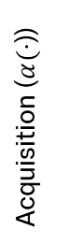
Bayesian Optimization
Background
Surrogate model
A probabilistic estimate of the true function
We use a GP
Optimization problem
$$P(f\left(⋅\right))$$
$$f(⋅)$$
Surrogate model
mean function
covariance function
Dependency structure
Acquisition function
$$X_{1}$$
$$X_{2}$$
…
$$X_{d}$$
Function we optimize at each step of the algorithm
Optimize using the surrogate model
Acquisition ($α(⋅$))
Expected improvement
…
$$Y$$
Optimizing a black-box function
Entropy search
$$X_{1}$$
$$X_{2}$$
$$X_{D}$$

Slide 6
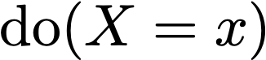
Causality
Background
Causality framework
Observational distribution
Interventional distribution
X
X
$$X_{1}$$
Y
Z
Y
Z
Y
cause
effect
Data is collected by observing the system
Data is collected by actively intervening on the system
Pearl’s framework of causality

Slide 7
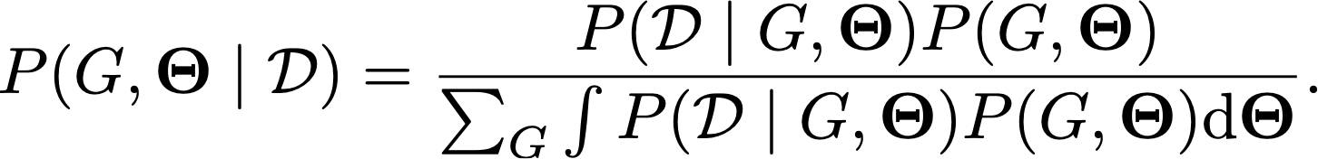

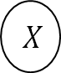
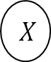
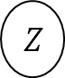

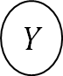
Causal Discovery
Background
Overview
Bayesian Approach
Learning the causal structure from data
The problem is non-identifiable using observational data
Interventional data improves identifiability of the causal graph
likelihood
prior
Markov Equivalent DAGs
marginal
$$X$$
$$Y$$
$$X$$
$$Y$$
Allows us to capture the epistemic uncertainty over the graphs
$$W$$
$$Z$$
$$W$$
$$Z$$

Slide 8
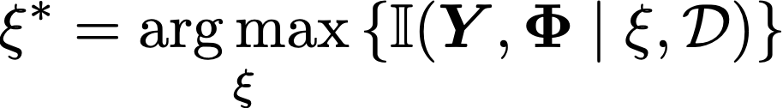
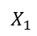
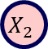


Bayesian Optimal Experimental Design
Background
Overview
Objective
It is a downstream task for Bayesian Causal Discovery
Interventions in the real-world are costly
Selects interventions to learn the causal graph
EIG
outcome
selected experiment
parameters
$$X_{1}$$
$$X_{2}$$
EIG
$$X_{D}$$
…
$$X_{1}$$
$$X_{2}$$
$$X_{D}$$

Slide 9




Causal Bayesian Optimization
Background
Overview
Objective
target variable
Selects interventions to optimize Y
Addresses two key issues of BO:
BO does not scale
BO breaks the dependency structure of a causal model
optimal intervention
CBO
BO
$$X$$
$$X$$
$$Z$$
$$Y$$
$$Y$$
$$Z$$
Optimizing over a causal model

Slide 10












Summary of methods
Background
Select experiment
…
BO | max $α(⋅)$
BOECD | max EIG
CBO | max $α(⋅)$
$$X_{1}$$
$$X_{2}$$
…
$$X_{D}$$
Return
BO | $$X^{∗}, Y^{∗}$$
BOECD | $$G, Θ$$
CBO | $$X^{∗}, Y^{∗}$$
Get data
Update beliefs
Initial data ($D_{obs}$ )
BO | query $f(⋅)$
BOECD | do$(⋅)$
CBO | do$(⋅)$
BO | $$P(f\left(⋅\right))$$
BOECD | $$P(Φ∣D)$$
CBO | $$P(f\left(⋅\right))$$
$$P(f\left(⋅\right))$$
$$X_{1}$$
$$f(⋅)$$
$$X_{2}$$
Y
Notes:
7.30

Slide 11


Motivating experiment
$$X_{1}$$
Y
$$X_{2}$$
Y
$$X_{1}$$
$$X_{2}$$
$$X_{D}$$
Y
$$X_{D}$$
$$P(f\left(⋅\right))$$
$$f(⋅)$$
Surrogate model

Slide 12










Misspecified DAGs
Motivating Experiments
DAGs
Priors
Posterior
True DAG
$$X$$
$$Z$$
$$Y$$
Misspecified DAG
An incorrectly specified DAG leads to a poor prior estimate of the surrogate model, resulting in a poor fit even with interventional data
$$Z$$
$$X$$
$$Y$$

Slide 13


Motivating Experiments
Direct parents
Question
Results
How important are the edges, not directly connected to the target, in the CBO problem?
 | Method | Best Y | Average Y
Toy | CBO | -1.969 ± 0.109 | -1.701 ± 0.303
 | CBO parents | -1.978 ±0.122 | -1.749 ±0.255
Healthcare | CBO | 13.217 ± 0.014 | 13.338 ±0.206
 | CBO parents | 13.214± 0.013 | 13.373 ± 0.237
Epidemiology | CBO | -1.514± 0.020 | -1.397 ± 0.190
 | CBO parents | -1.498 ± 0.028 | -1.101 ± 0.519
Experiment
Use a simulated Toy example, Healthcare example and Epidemiology example
CBO
CBO parents
Method is competitive with CBO and outperforms other benchmarks
$$X$$
$$Z$$
$$Y$$
$$Z$$
$$Y$$
Notes:
9.0

Slide 14
Methodology
$$X_{1}$$
Y
$$X_{2}$$
Y
$$X_{1}$$
$$X_{2}$$
$$X_{D}$$
Y
$$X_{D}$$
$$P(f\left(⋅\right))$$
$$f(⋅)$$
Surrogate model

Slide 15











Methodology Overview
Methodology
Select experiment
…
BO | max $α(⋅)$
BOECD | max EIG
CBO | max $α(⋅)$
$$X_{1}$$
$$X_{2}$$
…
$$X_{D}$$
Return
max$α(⋅)$
BO | $$X^{∗}, Y^{∗}$$
BOECD | $$G, Θ$$
CBO | $$X^{∗}, Y^{∗}$$
Get data
Update beliefs
Initial data ($D_{obs}$ )
$$X_{1}$$
$$X_{2}$$
Y
$X^{∗},Y^{∗}$ $+ G, Θ$
BO | query $f(⋅)$
BOECD | do$(⋅)$
CBO | do$(⋅)$
$$P(f\left(⋅\right))$$
BO | $$P(f\left(⋅\right))$$
BOECD | $$P(Φ∣D)$$
CBO | $$P(f\left(⋅\right))$$
$$f(⋅)$$
Full graph
Direct parents
do$(⋅)$
$$P(f\left(⋅\right))$$
$$P(Φ∣D)$$
Direct parents

Slide 16











Theoretical Motivation
Methodology
Observational DAG
Interventional DAG
Direct parents
Observational
$$X_{3}$$
$$X_{4}$$
$$X_{1}$$
$$X_{2}$$
$$X_{1}$$
$$X_{2}$$
Y
$$X_{3}$$
$$X_{4}$$
$$X_{3}$$
$$X_{4}$$
Interventional
$$X_{3}$$
$$X_{4}$$
Y
Y
Y
Both interventional DAGs are equivalent

Slide 17








Posterior Distribution
Methodology
$$X_{1}$$
Y
Gaussian ANM
$$X_{2}$$
Y
$$X_{D}$$
Y
Linear Case
Nonlinear Case
Suppose that
The probability that $g_{s}$ is the parent set of $Y$ is calculated as follow
likelihood
priors
Approximate $φ(X_{s})$ using Fourier Transforms
marginal

Slide 18












Solution
Methodology
Problem setup
Algorithm Steps
Get initial probabilities for $P(g)$ using the observational data and double machine learning
$$X_{1}$$
Y
Optimize target and learn graph
Use acquisition function to select intervention and intervene on the system
$$X_{1}$$
Surrogate Model
Update $P(g)$ using derived formula and $P\left(θ\right)$ using Bayesian Linear Regression
$$X_{1}$$
Y
Update GP $P(f\left(⋅\right))$ using the new interventional data point
$$P(f\left(⋅\right))$$
$$f(⋅)$$
Return best input in the data set
Introduce a latent variable to capture uncertainty in the graph as well
$$X_{i}^{∗}$$
$$Y^{∗}$$
Notes:
14.0

Slide 19
Results
$$X_{1}$$
Y
$$X_{2}$$
Y
$$X_{1}$$
$$X_{2}$$
$$X_{D}$$
Y
$$X_{D}$$
$$P(f\left(⋅\right))$$
$$f(⋅)$$
Surrogate model

Slide 20

Erdos-Renyi Graphs
Results
Question
Results
Can CBO Unknown scale to larger graphs?
Experiment setup
Test method on randomly generated linear and nonlinear Erdos-Renyi graphs
Benchmarks
Method is competitive with CBO even with no prior knowledge about the causal graph. Method outperforms Random in all cases.
CBO: Full knowledge of the graph (upper bound)
Random: Selects interventions randomly (lower bound)

Slide 21


Toy Examples
Results
Question
Results
How does CBO Unknown compare on existing benchmarks?
Method is competitive with CBO in the best case and outperforms CEO and BO in the average case
Experiment setup
Test method on simulated healthcare, toy and epidemiology examples
Method is converges faster than BO
Benchmarks
CBO: Full knowledge of the graph BO: Disregards causal knowledge
CEO: Learns full graph

Slide 22

Dream Experiment
Results
Question
Results
How does CBO Unknown perform on a downstream task?
Experiment setup
Test method on a causal discovery benchmark where arrows measure gene interactions
Benchmarks
CBO: Full knowledge of the graph (upper bound)
Random: Selects interventions randomly (lower bound)
Demonstrates the effectiveness in using real-world situations where the causal graph is unknown
Notes:
17.0

Slide 23
Conclusion
$$X_{1}$$
Y
$$X_{2}$$
Y
$$X_{1}$$
$$X_{2}$$
$$X_{D}$$
Y
$$X_{D}$$
$$P(f\left(⋅\right))$$
$$f(⋅)$$
Surrogate model

Slide 24



Conclusion
Conclusion
Further Work
Validate on real-world experiments
Extend to discrete interventions
Setup end-to-end benchmarking framework
Showed that learning the direct parents is sufficient for optimization
Derived expression for the posterior distribution
Validated the results
Acquisition ($α(⋅$))
…
$$X_{1}$$
$$X_{2}$$
…
$$X_{D}$$
$$X_{i}^{∗}$$
$$Y^{∗}$$
$$X_{1}$$
Y
$$X_{1}$$
$$X_{2}$$
Optimal intervention
Observational data ($D_{obs}$ )
$$X_{2}$$
Y
$$X_{D}$$
Y
Causal Hypothesis
$$X_{D}$$
$$+$$
$$P(f\left(⋅\right))$$
Intervene ($D_{int}$ )
$$f(⋅)$$
Surrogate model

Slide 25


Thank you
Acquisition ($α(⋅$))
…
$$X_{1}$$
$$X_{2}$$
…
$$X_{D}$$
$$X_{i}^{∗}$$
$$Y^{∗}$$
$$X_{1}$$
Y
$$X_{1}$$
$$X_{2}$$
Optimal intervention
Observational data ($D_{obs}$ )
$$X_{2}$$
Y
$$X_{D}$$
Y
Causal Hypothesis
$$X_{D}$$
$$+$$
$$P(f\left(⋅\right))$$
Intervene ($D_{int}$ )
$$f(⋅)$$
Surrogate model
Causal Bayesian Optimization with Unknown Causal Graphs
September 2024
Notes:
18.0

